Slide 1
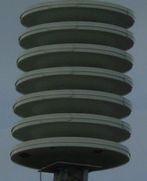
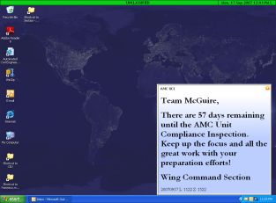
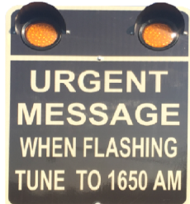
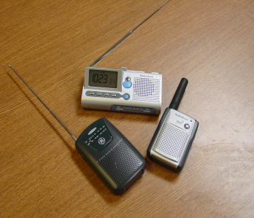
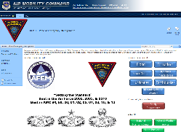
Installation Warning Systems
Giant Voice (GV) Siren System
(Steady Tone)
Tornado Warning
(Wavering Tone)
Active Shooter
(Voice Announcement)
All Clear
(The Tornado Threat Has Ended or the Active Shooter Incident is Over)
Ensure all personnel are warned/notified and accounted for.
Listen to and follow Warning System instructions.
Actions may include: Lockdown, Shelter In-Place, Evacuation, Staying Indoors to take cover, increasing appropriate security measures and accountability.
Bottom line: Stay Informed and Take Appropriate Actions.
The following notification systems broadcast valuable information to the base.
At a minimum, units must notify all personnel, perform accountability and report to Unit/Group Control Centers, the Command Post (609-754-3935) or Joint Base Control Center (JBCC) (609-754-0990)
At Hoc Alert System
Is a message alerting system that sends texts, emails, and phone calls to registered base population
At Hoc Desktop Alerting
Appears on equipped JB MDL government computers. Notification window remains displayed until user closes the box.
1650 AM Radio Station
When the lights on posted warning signs are flashing, tune your radio to 1650 AM to receive urgent information. Continue monitoring until the event has been terminated and the all clear announced. NOAA weather radio continuously plays until an urgent message is broadcast.
JB MDL OEM Social Media
www.facebook.com/jbmdl
www.twitter.com/jointbasemdl
www.flickr.com/jointbasemdl
SharePoint Site
You can also become a member of the “JB MDL Office of Emergency Management Sharepoint site”: https://eim.amc.af.mil/org/87ces/Office of Emergency Management/
JB MDL OEM VA-1(Locally replaces AFVA 10-2510), 6 Sep 2016, previous edition obsolete

